Slide 1

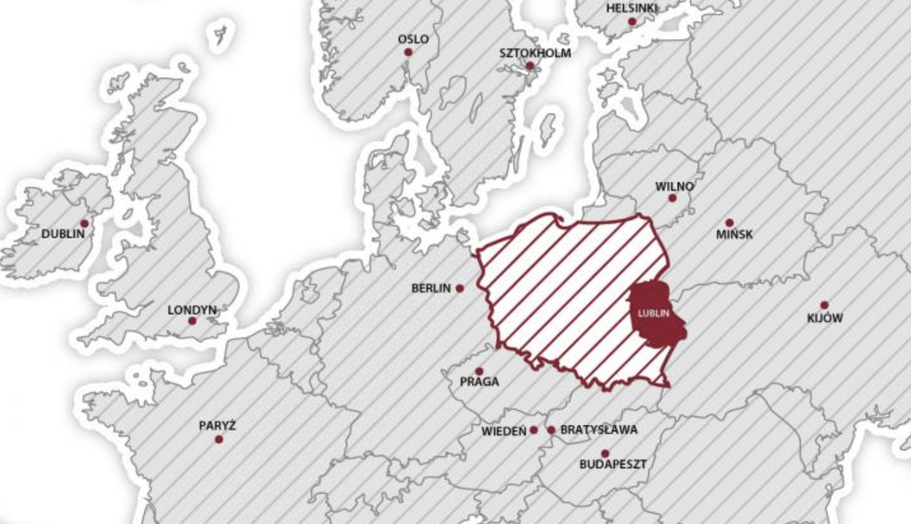

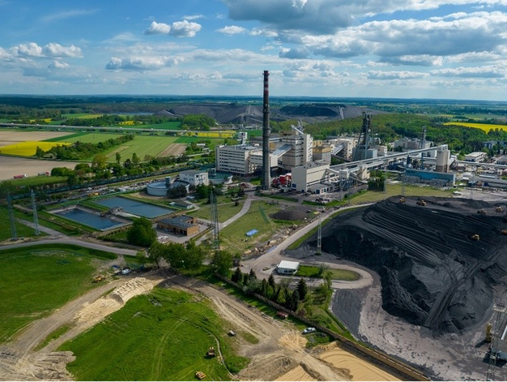
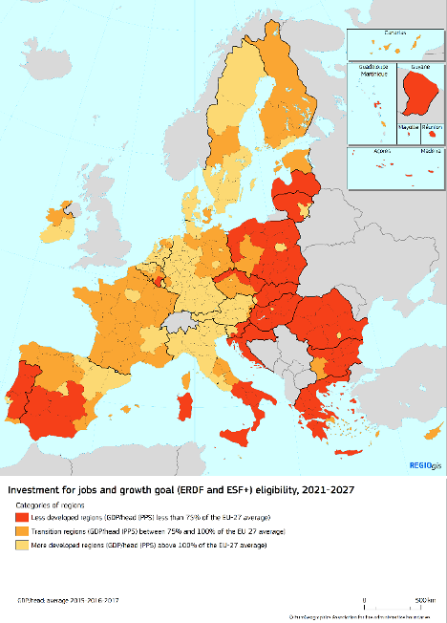
Learn about Lubelskie
Lubelskie, a voivodeship in eastern Poland
Economic snapshot
It is classified as a “less developed” region under EU Cohesion Policy 2021–2027.
It had the lowest GDP per capita in Poland in 2022, only about 54% of the EU average.
Its economy relies heavily on agriculture and mining, and is less diversified than Poland’s average.
It ranks last in the country for GVA per worker.
It faces an innovation gap – patent activity is over 10× lower than the EU average.
On the upside, the region shows entrepreneurial spirit: it has Poland’s highest rate of new business formation.
Social & Demographic Challenges
The highest poverty rate in Poland,about 22.9% of people lived below the national poverty line in 2021.
Overall unemployment was 4.7% in 2022 – lower than the EU average but the second highest in Poland.
Struggling with population decline. Between 2001 and 2021, its population shrank by 6% due to migration and low birth rates.
Climate & Energy Context
High emissions & coal reliance:It hosts Poland’s largest coal mine - the Bogdanka.
Insufficient clean energy use: Renewables generate just under 20% of Lubelskie’s electricity – less than half the EU average (43%)
Environmental vulnerability: nearly 47.5% of the region’s area is at heightened risk of drought
Notes:
GDP, population, industry strcuture, energy cosumption, funding situation
Gross Value Added (GVA) per worker measures labor productivity by dividing the total economic output (GVA) by the number of workers, often adjusted to GVA per hour worked for accuracy. It indicates how efficiently value is generated, with higher figures reflecting greater productivity

Slide 2
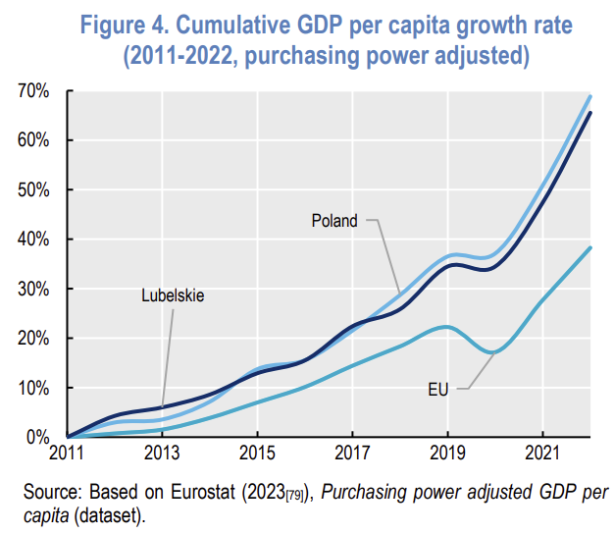
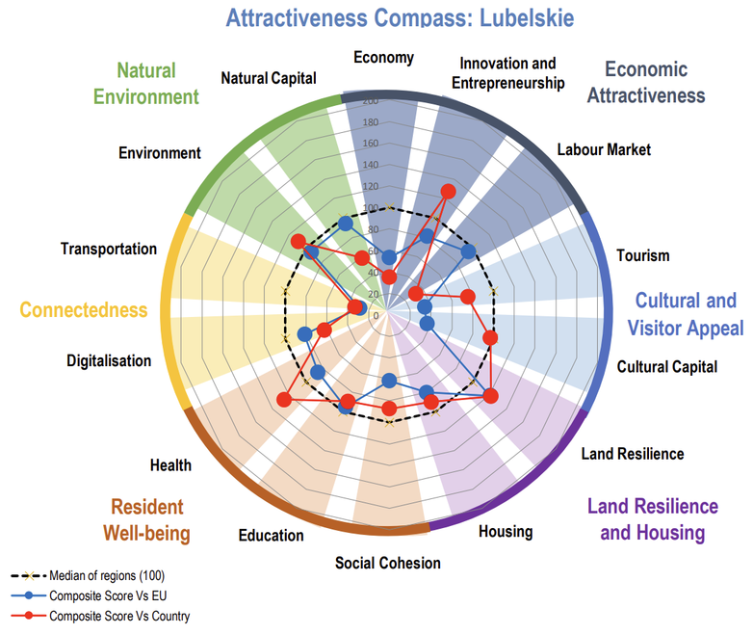
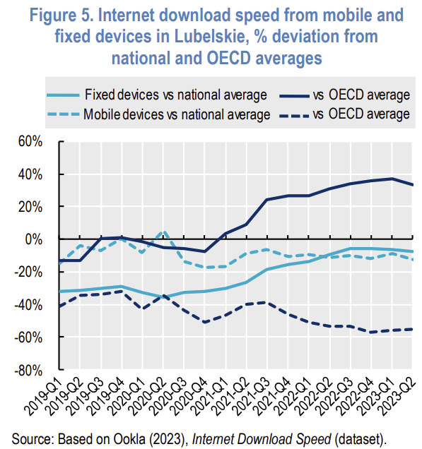
Learn about Lubelskie
Notes:
Gross Value Added (GVA) per worker measures labor productivity by dividing the total economic output (GVA) by the number of workers, often adjusted to GVA per hour worked for accuracy. It indicates how efficiently value is generated, with higher figures reflecting greater productivity

Slide 3


Why does it need funds (problems)
The European Regional Development Fund (ERDF) aims to reduce economic, social, and territorial disparities across EU regions by providing funding for various development projects.
Key Policy Objectives (2021-2027)
For the programming period of 2021-2027, the ERDF focuses on five main policy objectives:
A Smarter Europe: Promoting innovation and digital transformation.
A Greener, Carbon-Free Europe: Supporting the transition to renewable energy and sustainable practices.
A More Connected Europe: Enhancing transport and digital networks.
A More Social Europe: Fostering social inclusion and quality employment.
A Europe Closer to Citizens: Supporting locally-led development strategies.
The Just Transition Fund is a financial instrument under EU Cohesion Policy to mitigate the economic and social consequences of the energy and climate transition, especially in territories most dependent on fossil fuels and carbon-intensive industries.

Slide 4
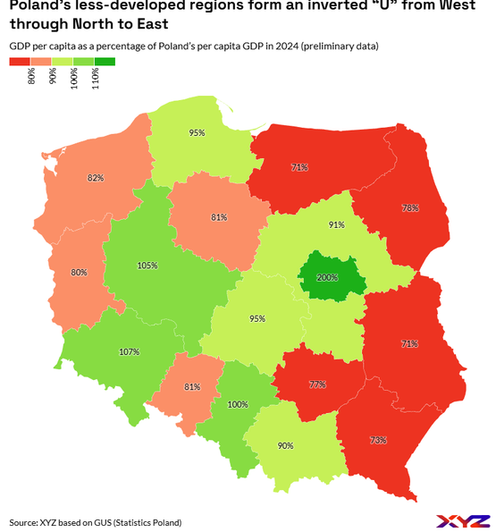
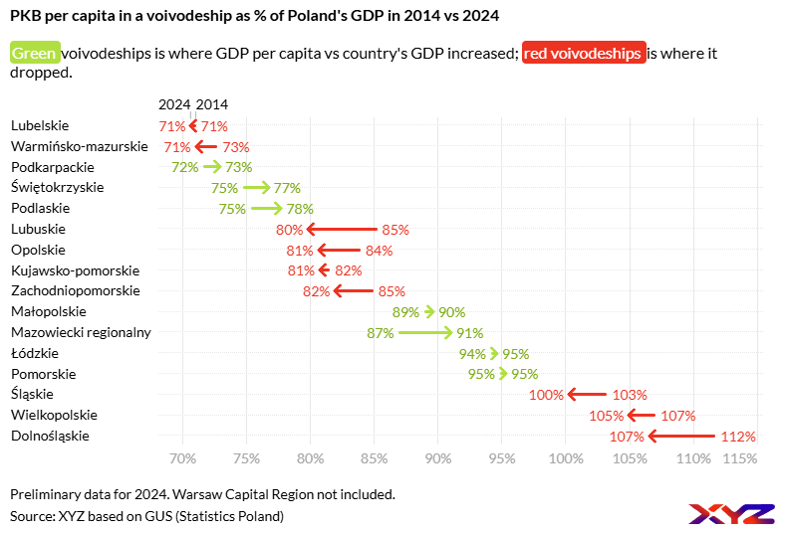
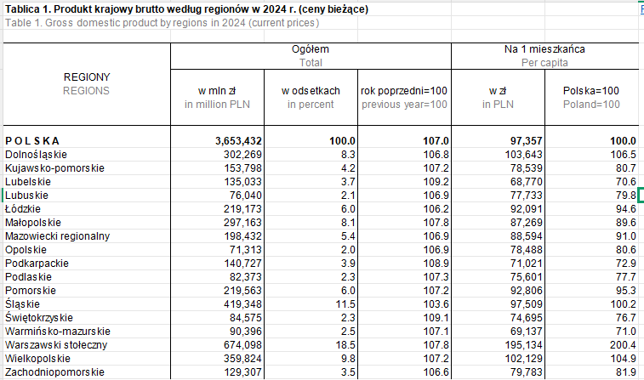
Problems
(1) Economically underdeveloped:
Lubelskie is one of the least developed regions in Poland, with GDP per capita at around 70.6% of the national average, compared to over 200% in the Warsaw capital region.
By contrast, JTF-supported regions (Silesia, Wielkopolska, Małopolska, Łódzkie, Lower Silesia) not only received funding but have stronger economic bases.
Data source: Statistic Poland
你的段落文字

Slide 5
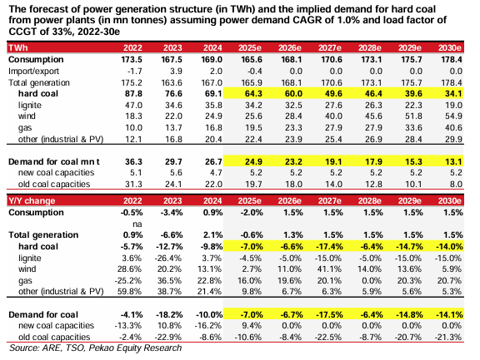
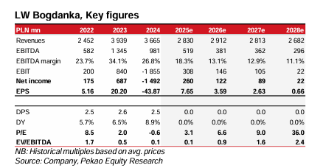
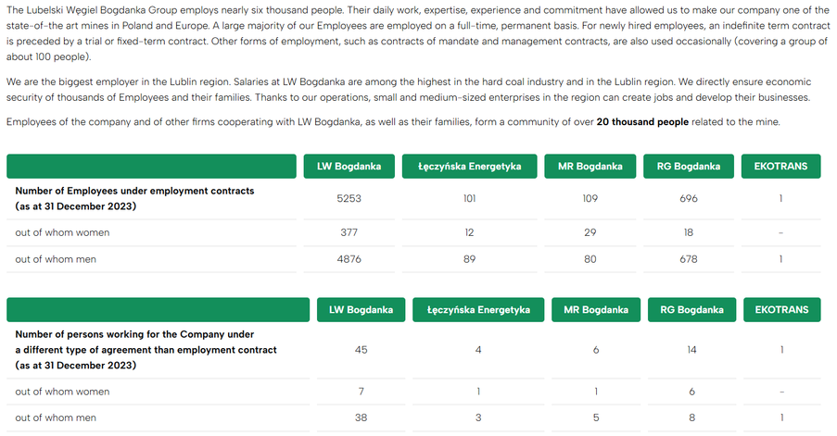
Problems
(2) Economic (industrial) fragility: The Risk of Industrial Pillar Collapse
Demand for thermal coal from power plants in Poland is projected to decline by 47–58% by 2030 compared to 2025 levels, falling from 24.9 million tonnes to 10.4–13.1 million tonnes.
The industrial resilience of the Lubelskie Voivodeship largely depends on Lubelski Węgiel Bogdanka (LW Bogdanka, LWB), whose operations and related industries directly and indirectly support the livelihoods of more than 20,000 people.
Bogdanka’s coal production is forecast to decline to 6.2 million tonnes by 2030, implying a structural contraction. The company’s EBITDA is expected to fall by around 30% in 2025–2027, with negative free cash flows projected through 2025–2031, signalling deteriorating financial sustainability.
Bogdanka operates with high fixed costs, with employment expenses accounting for 32–39% of total costs, meaning declining volumes directly threaten cost stability and workforce sustainability

Slide 6
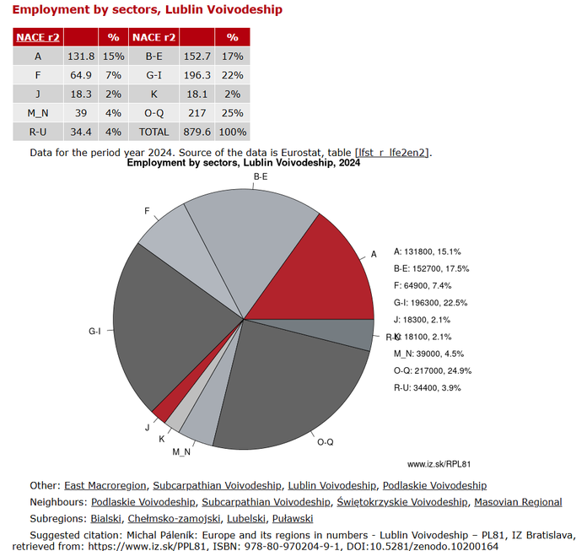
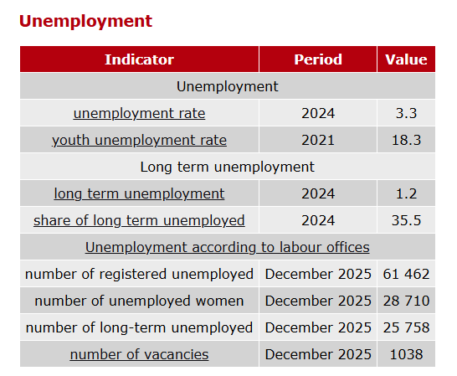
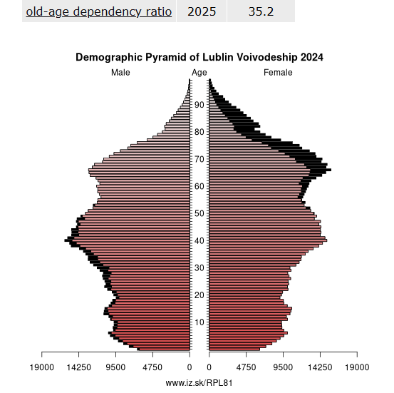
Problems
(3) Structural Labour Market Vulnerability and Demographic Pressure:
Lubelskie’s employment structure is highly concentrated in agriculture (15%) and mining (17%), and the mining sector is largely dominated by a single company, Bogdanka, making the regional labour market heavily dependent on a limited number of traditional industries.
The region exhibits labour market structural issues, including a youth unemployment rate of 18.3%, a long-term unemployment share of 35.5%, and 26.6% of the population at risk of poverty or social exclusion.
The old-age dependency ratio has reached 35.2%, indicating a pronounced demographic ageing trend in the region.
Lublin Voivodeship – PL81 - Employment Institute
你的段落文字

Slide 7
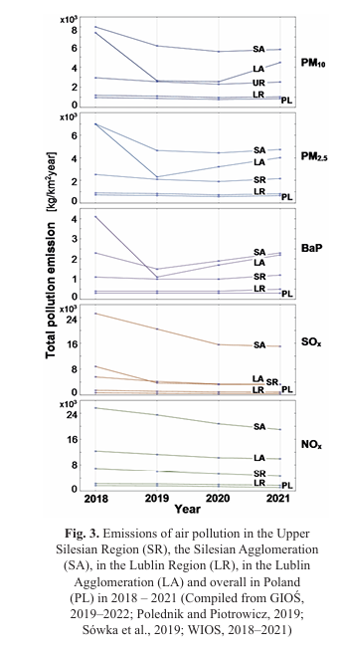
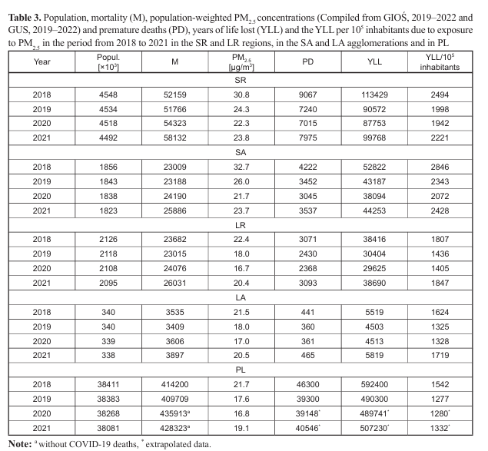
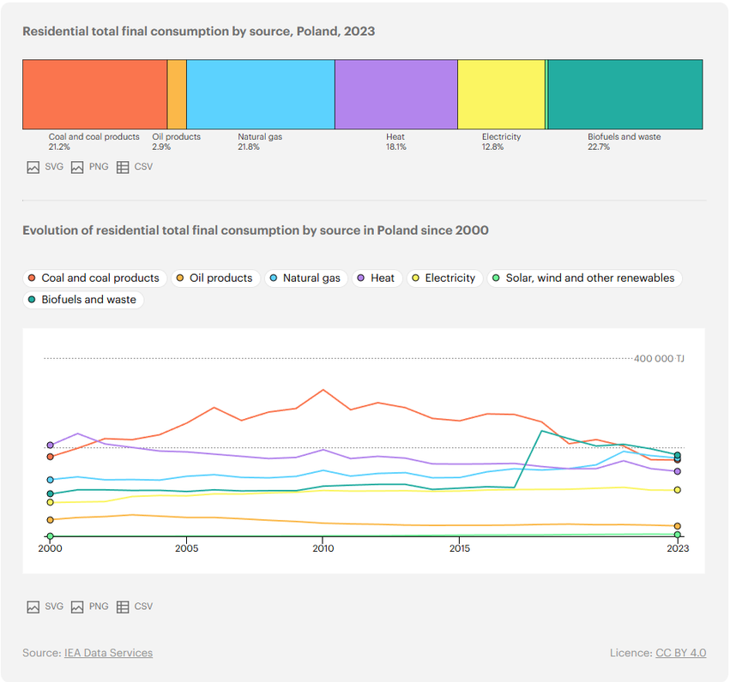
Problems
(4) Environmental Health Costs and Rising Energy Poverty
The Lublin Agglomeration exhibits pollution exposure levels comparable to major industrial urban areas, resulting in significant premature mortality and years of life lost.
In Lubelskie, PM₂.₅ exposure resulted in between 2,368 and 3,071 premature deaths annually between 2018 and 2020, with 3,071 deaths recorded in 2018 alone.
Poland’s residential energy consumption remains heavily dependent on coal: around 40.5% of households rely on solid fuels (mainly coal and wood) for space heating, and coal is still a major source in the residential sector. However, a shift in the energy mix from coal towards natural gas would increase household energy costs in the short term, as natural gas is a relatively more expensive fuel compared with coal and wood. Under a transition scenario without additional efficiency improvements, average household energy expenditures are projected to rise by approximately 22.9%.

Slide 8

Phase I: Found a Social Safety Net and Industrial Transformation (2025–2028)
Main objective: Mitigate the socio-economic shock of coal contraction and safeguard livelihoods during the energy transition.
[JTF] Reskilling Project
Targeting miners made redundant due to the energy transition and several thousand supply-chain workers, the programme will deliver 10,000 hours of green skills training, including wind turbine operation and maintenance, as well as digital management systems. The objective is to facilitate skills upgrading and ensure continued employability.
[JTF / ERDF] Industrial Redeployment through Green Hydrogen
Leverages the region’s existing coal-based industrial capabilities to establish pilot-scale green hydrogen production facilities. Hydrogen production retains the industrial character of the region while gradually decarbonising its energy base. By repurposing brownfield mining sites and integrating renewable electricity inputs, green hydrogen serves as a transitional platform that preserves skilled employment and industrial capacity.

Slide 9
Phase II: Innovation Acceleration and Industrial Development (2028–2035)
Main objective: Mitigate the socio-economic shock of coal contraction and safeguard livelihoods during the energy transition.
[JTF] Renewable Energy Expansion (Wind and Solar)
As hydrogen production depends on clean electricity inputs, the second phase prioritises large-scale deployment of wind and solar energy. Lubelskie’s rural land availability and grid potential enable distributed renewable expansion. Renewable generation becomes the structural backbone of the regional energy system, supplying electricity for households, industry, and hydrogen production.
[ERDF] Residential Energy Transition
Large-scale subsidies for deep thermal renovation of old housing stock, including insulation upgrades and heat pump installation, alongside financial support to facilitate the transition of household energy systems from coal to natural gas.
[ERDF] Green Technology Incubator
Leveraging the research capacity of Lublin’s university cluster to establish centres for bioeconomy and advanced materials, supporting the upgrading of the regional energy sector, creating high-skilled employment opportunities, and encouraging talent return.

